Slide 1

Web scraping to gain company insights

Slide 2
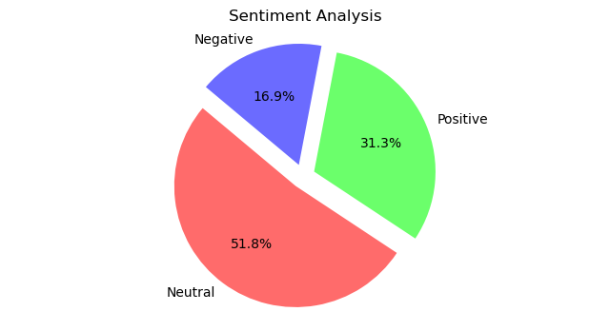
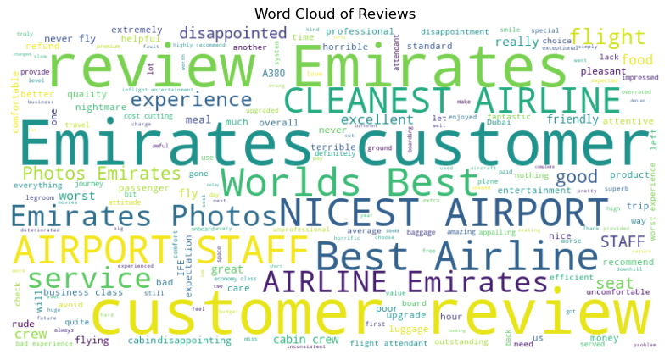
INSIGHTS FROM CUSTOMER REVIEWS
From cleaning 3228 reviews given by the customers, we obtained
Positive Reviews - 1011
Negative Reviews -545
Neutral Reviews – 1672
Word cloud of keywords used in reviews

